Slide 1

Reaction stoichiometry

Slide 2
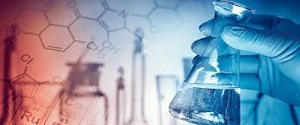
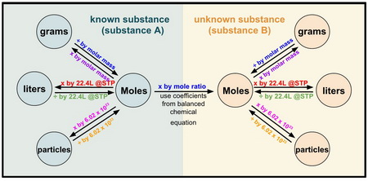
Overview
Stoichiometry – pronounced “Stoy-KEE-om-Metry”
Stoichiometry is the study of the relationship between the amounts of each reagents in a chemical reaction.
We will look at how we use a balanced chemical equation to determine the relative amounts of reagents and products involved in the reaction.
A lot of this presentation is a direct repeat of the early work we did on stoichiometry when looking at Fuels. I have included it again with the addition of gases as a revision and for the new students to the class.

Slide 3
Known substance
Unknown substance
Mass (g)
Mass (g)
x by molar mass
÷ by molar mass
÷ by molar mass
x by molar mass
÷ by 22.71 @STP
x by mole ratio
x by 22.71 @STP
Moles (mol)
Moles (mol)
Volume (L)
Volume (L)
x by 22.71 @STP
Use coefficient from balanced equation
÷ by 22.71 @STP
÷ by 6.02 x 10²³
x by 6.02 x 10²³
x by 6.02 x 10²³
÷ by 6.02 x 10²³
Particles
Particles

Slide 4
Balancing chemical equations
The first step is to write and balance the chemical equation – For an in-depth review see the presentation “Balancing Chemical Equations” (loom and ppt)
Steps to balancing a chemical equation:
If you are given a word equation, convert this into a formula equation
Count the number of atoms on each side of the equation
Adjust the numbers by changing the coefficients in front of the substances until the atom count on each size balances

Slide 5
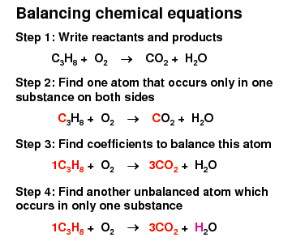
Balancing chemical equations
Practice questions:
magnesium + oxygen gas → magnesium oxide
HgCl_{2 (aq)} + NaI _{(aq)} → HgI_{2 (s)} + NaCl _{(aq)}

Slide 6
Balancing chemical equations
Practice questions:
magnesium + oxygen gas → magnesium oxide
HgCl_{2 (aq)} + NaI _{(aq)} → HgI_{2 (s)} + NaCl _{(aq)}
2
Mg _{(s)} + O_{2 (g)} → MgO _{(s)}
2
2
2
HgCl_{2 (aq)} + NaI _{(aq)} → HgI_{2 (s)} + NaCl _{(aq)}

Slide 7
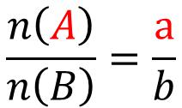
Mole to mole calculations
A general representation of a chemical equation:
aA + bB → cC + dD
A, B, C, D = the substances in the reaction
a, b, c, d = the reaction coefficients
Moles of A in the reaction
coefficient of A in the reaction
=
Moles of B in the reaction
coefficient of B in the reaction
$$\frac{n\left(A\right)}{n\left(B\right)}=\frac{a}{b}$$

Slide 8
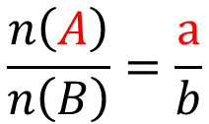
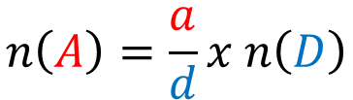
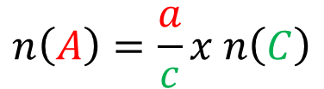
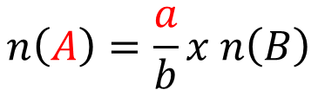
Mole to mole calculations
aA + bB → cC + dD
$$\frac{n\left(A\right)}{n\left(B\right)}=\frac{a}{b}$$
If we know the moles of A, we can calculate the moles of B
Rearranging this formula gives us a ways to calculated unknown amounts from known amounts:
$$n\left(A\right)=\frac{a}{b}x n\left(B\right)$$
or
$$n\left(A\right)=\frac{a}{c}x n\left(C\right)$$
or
$$n\left(A\right)=\frac{a}{d}x n\left(D\right)$$
In this way we can calculate the amount of all the components of a reaction as long as we have the balance equation and know the amount of one substance

Slide 9
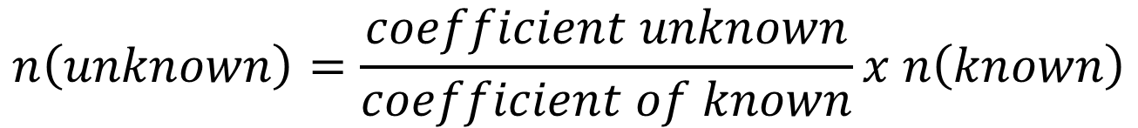
Mole to mole calculations
This can be simplified to the following relationship:
$$n\left(unknown\right)=\frac{coefficient unknown}{coefficient of known}x n\left(known\right)$$

Slide 10
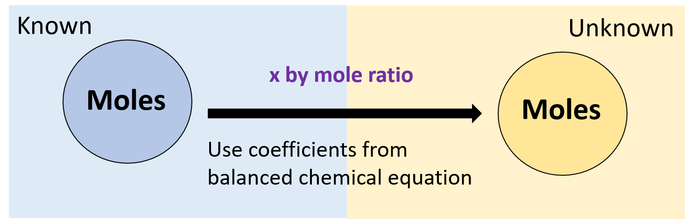
Mole to mole calculations
Practice question:
Magnesium reacts with hydrochloric acid according to the following balanced chemical equation:
If two moles of Hydrochloric acid react with excess Magnesium, how many moles of hydrogen gas are produced?
Mg_{(s)} + 2 HCl_{(aq)} → MgCl_{2(aq)} + H_{2(g)}

Slide 11
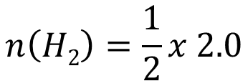

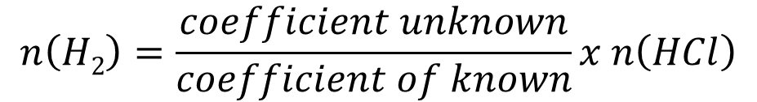
Mole to mole calculations
Magnesium reacts with hydrochloric acid according to the following balanced chemical equation:
If two moles of Hydrochloric acid react with excess Magnesium, how many moles of hydrogen gas are produced?
Mg_{(s)} + 2 HCl_{(aq)} → MgCl_{2(aq)} + H_{2(g)}
n(HCl) = 2.0 mol
n(H₂) = ?
$$n\left(H2\right)=\frac{coefficient unknown}{coefficient of known}x n\left(HCl\right)$$
$$n\left(H2\right)=\frac{1}{2}x 2.0$$
$$n\left(H2\right)=1.0 mol$$

Slide 12
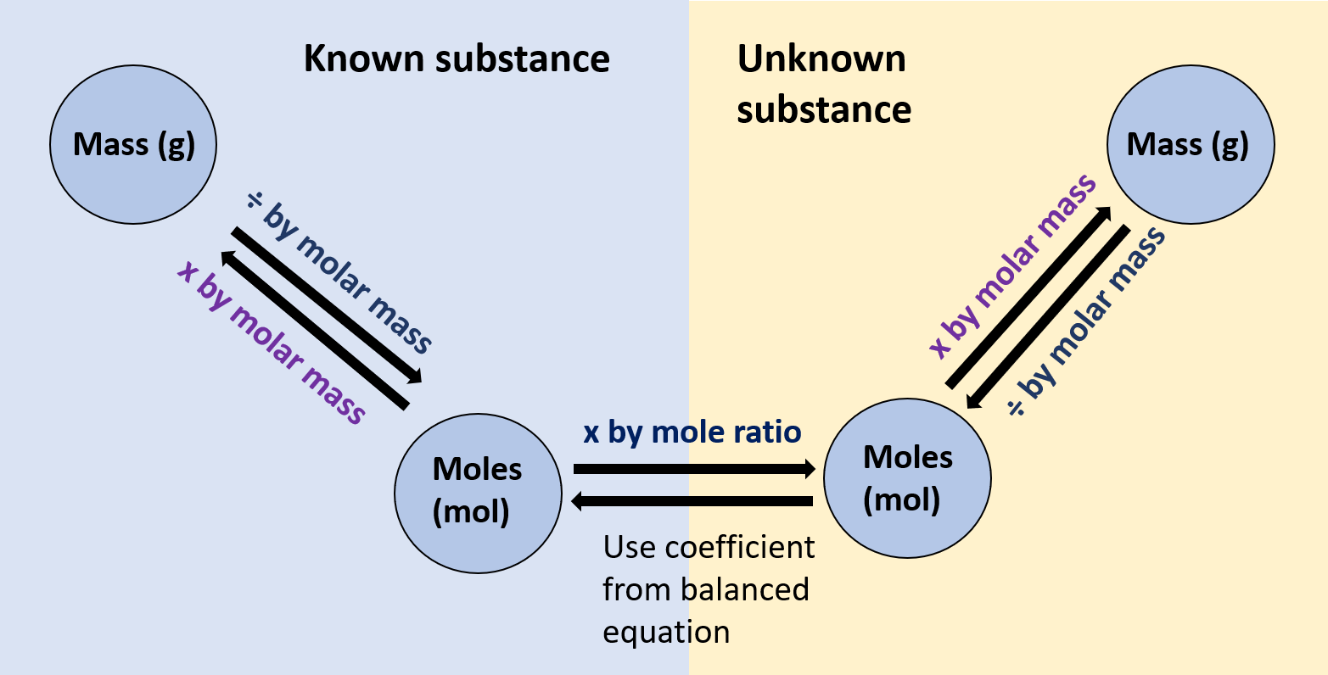
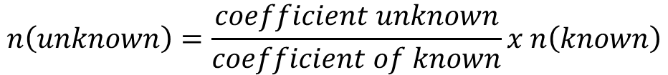
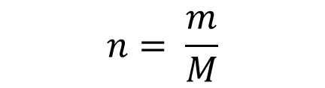
Mass to moles
$$n= \frac{m}{M}$$
$$n\left(unknown\right)=\frac{coefficient unknown}{coefficient of known}x n\left(known\right)$$
Relevant equations:
and

Slide 13
Mass to moles
Practice Question:
In a reaction, 50.0 g of manganese(IV) oxide reacts with excess aluminum. Calculate the mass of manganese metal produced.
3 MnO_{2(s)} + 4 Al_{(s)} → 3 Mn_{(s)} + 2 Al₂O_{3(s)}

Slide 14


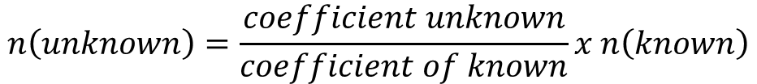
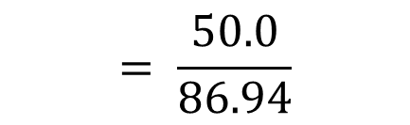

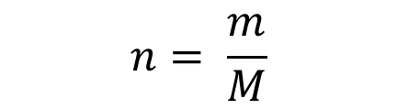

Mass to moles
3 MnO_{2(s)} + 4 Al_{(s)} → 3 Mn_{(s)} + 2 Al₂O_{3(s)}
50.0 g
m =?
$$= \frac{50.0}{86.94}$$
$$n= \frac{m}{M}$$
m(MnO₂) = 50.0 g
n(MnO₂) = ?
M(MnO₂) = 86.94 g mol⁻¹
n(MnO₂) = 0.575 mol
n(Mn) = ?
$$n\left(unknown\right)=\frac{coefficient unknown}{coefficient of known}x n\left(known\right)$$
$$n\left(Mn\right)=\frac{3}{3}x 0.575$$
$$n\left(Mn\right)=0.575 mol$$
m(Mn) = ?
$$m=n×M$$
M(Mn) = 54.94 g mol⁻¹
$$=0.575×54.94$$
m(Mn) = 31.6 g
31.6 g of manganese would be produced

Slide 15
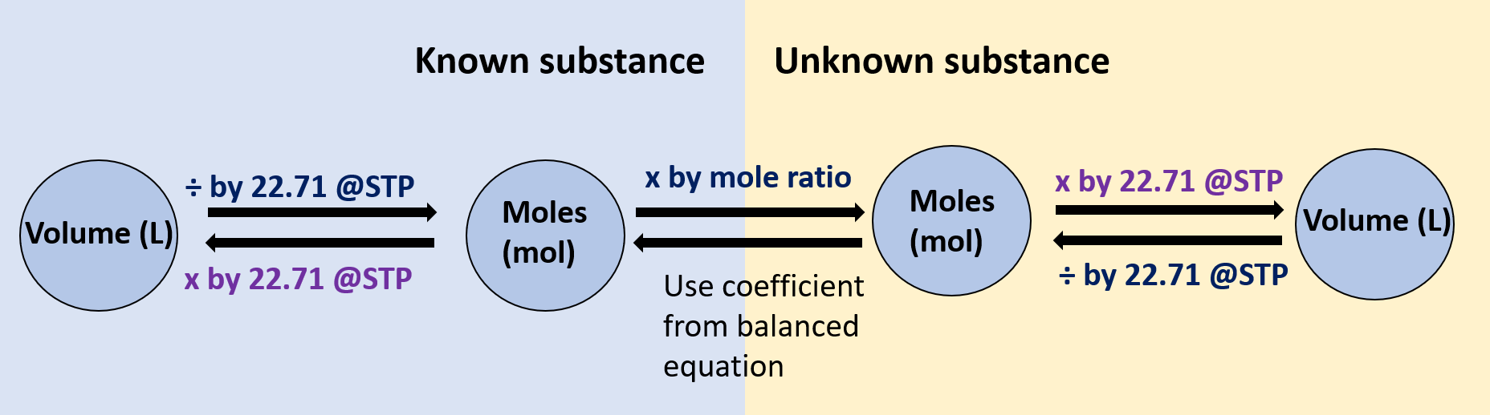
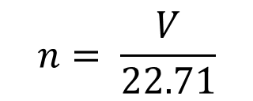
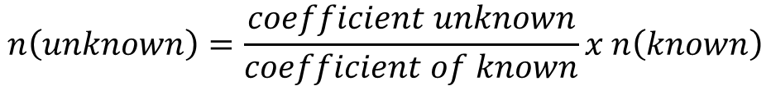
Volume to moles
$$n= \frac{V}{22.71}$$
$$n\left(unknown\right)=\frac{coefficient unknown}{coefficient of known}x n\left(known\right)$$
Relevant equations:
and

Slide 16
Volume to moles
Practice Question:
What volume of nitrogen gas is required to produce 45L of ammonia at STP?
N_{2(g)} + 3 H_{2(g)} → 2 NH_{3(g)}

Slide 17
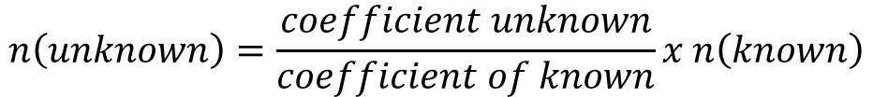




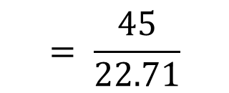

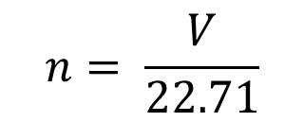

Volume to moles
N_{2(g)} + 3 H_{2(g)} → 2 NH_{3(g)}
v = ?
45L
$$n= \frac{V}{22.71}$$
$$= \frac{45}{22.71}$$
v(NH₃) = 45 L
$$n\left(\text{NH}\text{3}\right)=1.981 mol$$
$$n\left(\text{N}\text{2}\right)= ?$$
$$n\left(unknown\right)=\frac{coefficient unknown}{coefficient of known}x n\left(known\right)$$
$$n\left(\text{N}\text{2}\right)=\frac{1}{2}x 1.981$$
$$=0.991 mol$$
v(N₂) = ?
$$V=n×22.71$$
$$=0.991×22.71$$
v(N₂) = 23 L
23 L of nitrogen gas would be required

Slide 18
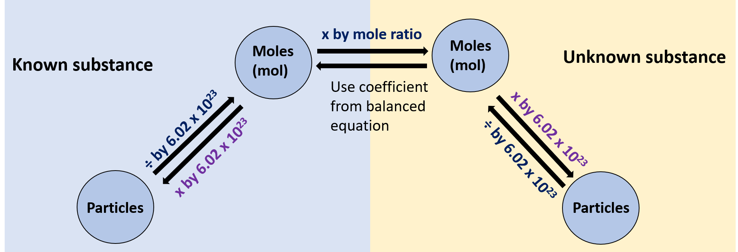
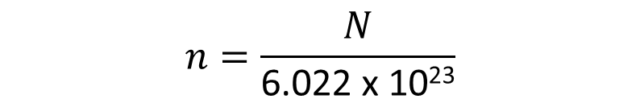
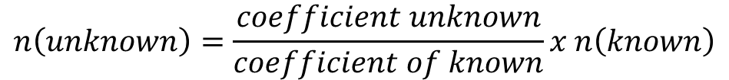
Particles to moles
Relevant equations:
$$n=\frac{N}{\text{6.022 }\text{x}\text{ 1023}}$$
$$n\left(unknown\right)=\frac{coefficient unknown}{coefficient of known}x n\left(known\right)$$
and

Slide 19
Particles to moles
Practice Question:
How many molecules of carbon disulfide will react with 4.21 x 10¹⁹ molecules of oxygen at STP?
___ CS₂ + ___ O₂ → ___ CO₂ + ___ SO₂

Slide 20



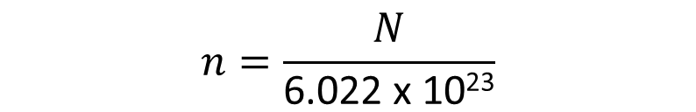
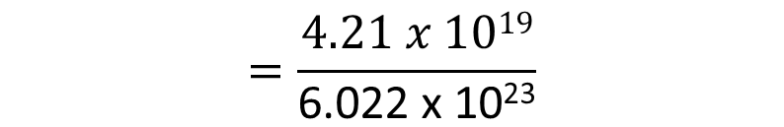




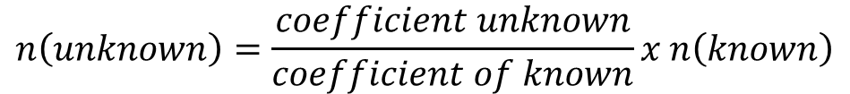

Particles to moles
3
2
___ CS₂ + ___ O₂ → ___ CO₂ + ___ SO₂
?
molecules
4.21 x 10¹⁹
molecules
$$n=\frac{N}{\text{6.022 }\text{x}\text{ 1023}}$$
$$N\left(O2\right)=4.21 x 1019$$
$$n\left(\text{O}\text{2}\right)= ?$$
$$=\frac{4.21 x 1019}{\text{6.022 }\text{x}\text{ 1023}}$$
$$n\left(\text{O}\text{2}\right)=$$
6.99 x 10⁻⁵ mol
$$n\left(\text{CS}\text{2}\right)= ?$$
$$n\left(unknown\right)=\frac{coefficient unknown}{coefficient of known}x n\left(known\right)$$
$$n\left(\text{CS}\text{2}\right)=\frac{1}{3}x \text{6.99 }\text{x}\text{ 10−5}$$
= 2.33 x 10⁻⁵ mol
$$N\left(CS2\right)= ?$$
$$N=n x \text{6.022 }\text{x}\text{ 1023 }$$
$$=\text{1.40} \text{x}\text{ 1019 }$$
molecules of CS₂

Slide 21
Known substance
Unknown substance
Mass (g)
Mass (g)
x by molar mass
÷ by molar mass
÷ by molar mass
x by molar mass
÷ by 22.71 @STP
x by mole ratio
x by 22.71 @STP
Moles (mol)
Moles (mol)
Volume (L)
Volume (L)
x by 22.71 @STP
Use coefficient from balanced equation
÷ by 22.71 @STP
÷ by 6.02 x 10²³
x by 6.02 x 10²³
x by 6.02 x 10²³
÷ by 6.02 x 10²³
Particles
Particles

Slide 22
Ongoing work
Pearson – calculations involving gases and chapter review for gases
STAWA Set 29 and 30

